Slide 1
KANDUNGAN KALORI DALAM PEMAKANAN DAN JUMLAH YANG DIBAKAR SEMASA SENAMAN/ AKTIVITI
KLINIK PELAJAR

Slide 2
3 PRINSIP PEMAKANAN SIHAT
PELBAGAI
SEIMBANG
SEDERHANA

Slide 3
MESEJ UTAMA
Makan pelbagai jenis makanan mengikut cadangan keperluan pengambilan tenaga anda.
  Berpandukan Piramid Makanan Malaysia
  Berpandukan saiz sajian yang disarankan
  Tiada satu makanan yang membekalkan semua nutrien keperluan
SUMBER: PANDUAN DIET MALAYSIA, KEMENTERIAN KESIHATAN MALAYSIA, 2010

Slide 4
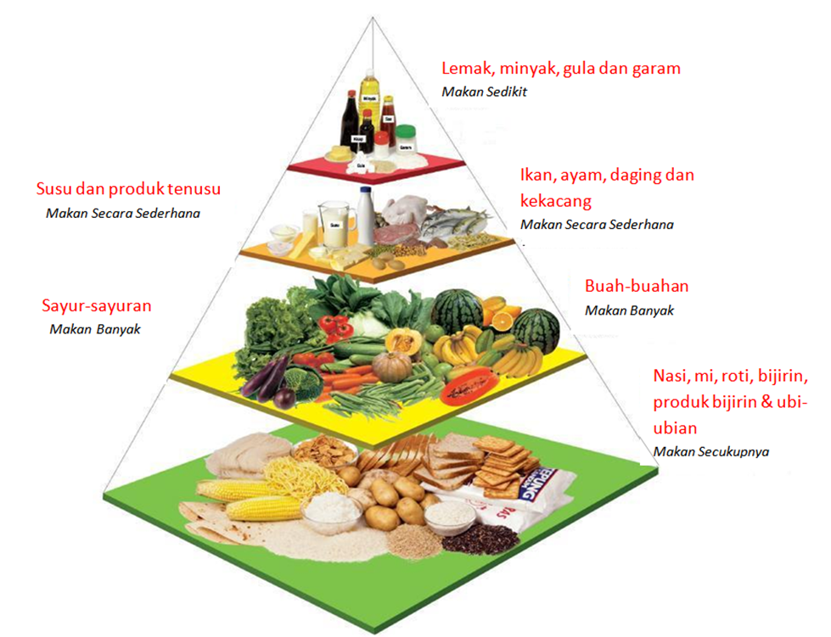
Piramid Makanan
Malaysia
(1500 hingga 2500 kkal/hari)
Ikan: 1 sajian/ hari
Ayam/ daging/ telur: ½ - 2 sajian/ hari
Kekacang: ½ - 1 sajian/ hari
1 – 3 Sajian/ hari
2 Sajian/ hari
3 Sajian/ hari
4 – 8 Sajian/ hari

Slide 5
PENGIRAAN
INDEKS JISIM TUBUH (IJT)
BERAT (KG) : IJT
TINGGI (M) X TINGGI (M)
***********************************
CONTOH : Pn. YY
berat 60kg, tinggi 150cm
60.0 KG : 26.7
1.50 (M) x 1.50 (M)

Slide 6
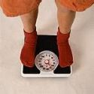
APAKAH BERAT BADAN
UNGGUL/ IDEAL ?
Berat badan unggul adalah apabila
IJT anda berada pada
18.5-22.9
dalam pengkelasan IJT.

Slide 7
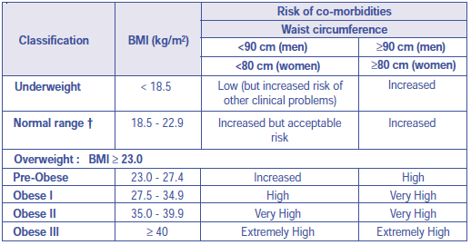
Pengelasan IJT/ BMI Mengikut CPG Obesiti, 2004

Slide 8
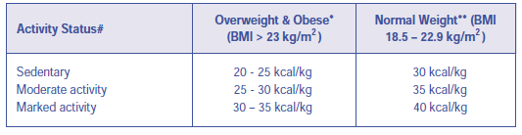
Pengiraan Keperluan Tenaga untuk Menurunkan/ Mengekalkan Berat Badan Mengikut CPG Obesiti, 2004

Slide 9
Makanan Kegemaran Anda
  Mee
 | Makanan | Pinggan | Kalori
1. | Mee mamak goreng | 1 | 660
2. | Mee rebus | 1 | 556
3. | Mee hailam | 1 | 277
4. | Mee hoon goreng | 1 | 510
5. | Mee wanton | 1 | 217
6. | Mee sup | 1 | 381
7. | Laksa penang | 1 | 436
8. | Laksa kari | 1 | 589

Slide 10
Makanan Kegemaran Anda
      Nasi
 | Makanan | Pinggan | Kalori
1. | Nasi putih | 1 | 207
2. | Nasi briyani kambing | 1 | 587
3. | Nasi rendang lembu | 1 | 664
4. | Nasi ekonomi 1 + 3 | 1 | 620
5. | Nasi lemak bagus | 1 | 644
6. | Nasi kerabu | 1 | 360
7. | Nasi ayam | 1 | 600
8. | Nasi goreng telur | 1 | 637
9. | Bubur ayam | 1 | 348
10. | Bubur nasi | 1 | 182

Slide 11
Makanan Kegemaran Anda
Roti
 | Makanan | Pinggan | Kalori
1. | Roti biasa | 1 | 75
2. | Papadum | 1 | 26
3. | Roti canai biasa + dhall | 1 | 359
4. | Roti canai telur + dhall | 1 | 414
5. | Capati + dhall | 1 | 166
6. | Murtabak kambing | 1 | 722
7. | Roti bun ayam | 1 | 204
8. | Roti bun kaya | 1 | 219
9. | Roti bun kacang merah | 1 | 223
10. | Curry puff | 1 | 256

Slide 12
Makanan Kegemaran Anda
Sapuan
 | Makanan | Bilangan sudu teh | Kalori
1. | Butter, marjerin, mayonis | 1 | 45
2. | Peanut butter | 1 | 33
3. | Kaya | 1 | 39
4. | Jam | 1 | 20

Slide 13
Makanan Kegemaran Anda
Fruits
 | Makanan | Bilangan | Kalori
1. | Anggur | 8 | 60
2. | Langsat | 10 | 31
3. | Guava | ½ | 60
4. | Mangga | ½ | 67
5. | Durian | 2 | 60
6. | Pisang | 1 | 60
7. | Epal merah | 1 | 63
8. | Tembikai | 1 | 60
9. | Papaya | 1 | 56

Slide 14
Makanan Kegemaran Anda
Kuih Tradisional Malaysia
 | Makanan | Hidangan kuih | Kalori
1. | Cucur udang | 1 | 144
2. | Vadai | 1 | 194
3. | Yau-car-kueh | 1 | 292
4. | Donut | 1 | 268
5. | Pisang goreng | 1 | 129
6. | Ham-chi-peng | 1 | 233
7. | Apam balik | 1 | 282

Slide 15
Makanan Kegemaran Anda
Kuih Tradisional Malaysia
8. | Kek | 1 | 100
9. | Dumpling ayam | 1 | 203
10. | Koci | 1 | 183
11. | Talam seri kaya | 1 | 183
12. | Ang koo kuih, mugbean | 1 | 111
13. | Ang koo kuih, peanut | 1 | 194
14. | Kek keladi | 1 | 174
15. | Popiah goreng | 1 | 91

Slide 16
Makanan Kegemaran Anda
Daging dan Makanan Laut
1. | Kuah kacang | ½ cawan | 129
2. | Rendang daging | 2 ketul kecil | 228
3. | Kari daging | 2 ketul kecil | 287
4. | Daging luncheon | 1 keping | 93
5. | Char siew | 1 pinggan kecil | 191
6. | Kari ayam | 1 ketul | 195

Slide 17
Makanan Kegemaran Anda
Sayur
 | Makanan | Bilangan | Kalori
1. | Salad | 1 mangkuk | 100
2. | Sos salad | 1 sudu | 60
3. | Sayur goreng | 1 pinggan | 66
4. | Sayur lemak | 1 pinggan | 140

Slide 18
Makanan Kegemaran Anda
Sup
 | Makanan | Bilangan | Kalori
1. | Sup berkrim | 1 mangkuk | 375
2. | Sup kosong | 1 mangkuk | 200

Slide 19
Makanan Kegemaran Anda
Burger
 | Makanan | Bilangan | Kalori
1. | Burger daging | 1 | 317
2. | Burger keju | 1 | 341
3. | Burger daging + keju | 1 | 438
4. | Burger ikan +roti bun | 1 | 433
5. | Hot dog | 1 | 225
6. | Sundae coklat | 1 cawan | 380
7. | Pie epal | 1 | 260

Slide 20
Makanan Kegemaran Anda
Pizza
 | Makanan | Bilangan | Kalori
1. | Pepperoni daging | 1 keping | 155
2. | Daging, ayam, bawang | 1 keping | 242
3. | Ayam + nanas | 1 keping | 268
4. | Bawang + tomato | 1 keping | 149

Slide 21
Makanan Kegemaran Anda
Pasta dan spageti
 | Makanan | Bilangan | Kalori
1. | Keju dan sos daging | 1 pinggan kecil | 444
2. | Kosong | 1 pinggan kecil | 169

Slide 22
Makanan Kegemaran Anda
Ayam
 | Makanan | Bilangan | Kalori
1. | Ayam goreng | 1 ketul | 290
2. | Kepak ayam | 1 ketul | 166
3. | Peha ayam | 1 ketul | 320
4. | Kentang pusar | 1 cawan biasa | 87
5. | Coleslaw | 1 cawan kecil | 62
6. | Kentang goreng | 1 cawan kecil | 290

Slide 23
Makanan Kegemaran Anda
Sandwich
 | Makanan | Bilangan | Kalori
1. | Tuna | 1 | 174
2. | Ikan + salad | 1 | 328
3. | Ayam + salad | 1 | 481
4. | Ayam | 1 | 270

Slide 24
Makanan Kegemaran Anda
Snek
 | Makanan | Bilangan | Kalori
1. | Pasembur | 1 pinggan | 752
2. | Agar agar | 1 potong | 37
3. | Cendol | 1 mangkuk | 199
4. | Bubur chacha | 1 mangkuk | 165
5. | Bubur kacang hijau | 1 mangkuk | 244
6. | Yogurt | 1 cawan | 100
7. | Aiskrim | 2 scoop | 305
8. | Ais kacang | 1 mangkuk | 258
9. | Keropok kentang | 1 pek | 95
10. | Keju diproses | 1 keping | 54

Slide 25
Makanan Kegemaran Anda
Chinese wedding dinner
  2,000 kalori
Hari Raya open house
  1,900 kalori
Christmas party
  2,000 kalori

Slide 26
MESEJ UTAMA
Menjadi lebih aktif setiap hari
SUMBER: PANDUAN DIET MALAYSIA, KEMENTERIAN KESIHATAN MALAYSIA, 2010

Slide 27
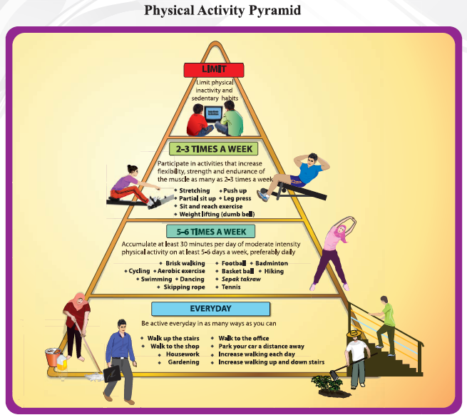
PIRAMID AKTIVITI FIZIKAL

Slide 28
Calories burned during exercise
Exercise & Calories Burned per Hour | 130 lbs 60kg | 155 lbs 70kg | 180 lbs 82kg | 205 lbs 93kg
Aerobics, general | 384 | 457 | 531 | 605
Aerobics, high impact | 413 | 493 | 572 | 651
Aerobics, low impact | 295 | 352 | 409 | 465
Aerobics, step aerobics | 502 | 598 | 695 | 791
Archery | 207 | 246 | 286 | 326

Slide 29
Calories burned during exercise
Backpacking, Hiking with pack | 413 | 493 | 572 | 651
Badminton | 266 | 317 | 368 | 419
Bagging grass, leaves | 236 | 281 | 327 | 372
Bakery, light effort | 148 | 176 | 204 | 233
Ballet, twist, jazz, tap | 266 | 317 | 368 | 419
Ballroom dancing, fast | 325 | 387 | 449 | 512

Slide 30
Calories burned during exercise
Ballroom dancing, slow | 177 | 211 | 245 | 279
Basketball game, competitive | 472 | 563 | 654 | 745
Basketball, playing, non game | 354 | 422 | 490 | 558
Basketball, shooting baskets | 266 | 317 | 368 | 419
Basketball, wheelchair | 384 | 457 | 531 | 605
Bathing dog | 207 | 246 | 286 | 326

Slide 31
Calories burned during exercise
Bird watching | 148 | 176 | 204 | 233
Boating, power, speed boat | 148 | 176 | 204 | 233
Bowling | 177 | 211 | 245 | 279
Boxing, in ring | 708 | 844 | 981 | 1117
Boxing, punching bag | 354 | 422 | 490 | 558
Boxing, sparring | 531 | 633 | 735 | 838

Slide 32
Calories burned during exercise
Calisthenics, light, pushups, situps… | 207 | 246 | 286 | 326
Calisthenics, fast, pushups, situps… | 472 | 563 | 654 | 745
Canoeing, camping trip | 236 | 281 | 327 | 372
Canoeing, rowing, light | 177 | 211 | 245 | 279
Canoeing, rowing, moderate | 413 | 493 | 572 | 651
Canoeing, rowing, vigorous | 708 | 844 | 981 | 1117

Slide 33
Calories burned during exercise
Carpentry, general | 207 | 246 | 286 | 326
Carrying 16 to 24 lbs, upstairs | 354 | 422 | 490 | 558
Carrying 25 to 49 lbs, upstairs | 472 | 563 | 654 | 745
Carrying heavy loads | 472 | 563 | 654 | 745
Carrying infant, level ground | 207 | 246 | 286 | 326
Carrying infant, upstairs | 295 | 352 | 409 | 465

Slide 34
Calories burned during exercise
Carrying moderate loads upstairs | 472 | 563 | 654 | 745
Carrying small children | 177 | 211 | 245 | 279
Children's games, hopscotch... | 295 | 352 | 409 | 465
Circuit training, minimal rest | 472 | 563 | 654 | 745
Cleaning gutters | 295 | 352 | 409 | 465
Cleaning, dusting | 148 | 176 | 204 | 233

Slide 35
Calories burned during exercise
Climbing hills, carrying up to 9 lbs | 413 | 493 | 572 | 651
Climbing hills, carrying 10 to 20 lb | 443 | 528 | 613 | 698
Climbing hills, carrying 21 to 42 lb | 472 | 563 | 654 | 745
Climbing hills, carrying over 42 lb | 531 | 633 | 735 | 838
Coaching: football,basketball,soccer | 236 | 281 | 327 | 372
Coal mining, general | 354 | 422 | 490 | 558

Slide 36
Calories burned during exercise
Construction, exterior, remodeling | 325 | 387 | 449 | 512
Crew, sculling, rowing, competition | 708 | 844 | 981 | 1117
Cricket (batting, bowling) | 295 | 352 | 409 | 465
Croquet | 148 | 176 | 204 | 233
Cross country snow skiing, slow | 413 | 493 | 572 | 651
Cross country skiing, moderate | 472 | 563 | 654 | 745

Slide 37
Calories burned during exercise
Cross country skiing, racing | 826 | 985 | 1144 | 1303
Cross country skiing, uphill | 974 | 1161 | 1348 | 1536
Cross country skiing, vigorous | 531 | 633 | 735 | 838
Curling | 236 | 281 | 327 | 372
Cycling, <10mph, leisure bicycling | 236 | 281 | 327 | 372
Cycling, >20mph, racing | 944 | 1126 | 1308 | 1489

Slide 38
Calories burned during exercise
Cycling, 10-11.9mph, light | 354 | 422 | 490 | 558
Cycling, 12-13.9mph, moderate | 472 | 563 | 654 | 745
Cycling, 14-15.9mph, vigorous | 590 | 704 | 817 | 931
Cycling, 16-19mph, very fast, racing | 708 | 844 | 981 | 1117
Cycling, mountain bike, bmx | 502 | 598 | 695 | 791
Darts (wall or lawn) | 148 | 176 | 204 | 233

Slide 39
Calories burned during exercise
Diving, springboard or platform | 177 | 211 | 245 | 279
Downhill snow skiing, moderate | 354 | 422 | 490 | 558
Downhill snow skiing, racing | 472 | 563 | 654 | 745
Electrical work, plumbing | 207 | 246 | 286 | 326
Farming, baling hay, cleaning barn | 472 | 563 | 654 | 745
Farming, chasing cattle on horseback | 236 | 281 | 327 | 372

Slide 40
Calories burned during exercise
Farming, feeding horses or cattle | 266 | 317 | 368 | 419
Farming, feeding small animals | 236 | 281 | 327 | 372
Farming, grooming animals | 354 | 422 | 490 | 558
Fencing | 354 | 422 | 490 | 558
Fire fighter, climbing ladder, full gear | 649 | 774 | 899 | 1024
Fire fighter, hauling hoses on ground | 472 | 563 | 654 | 745

Slide 41
Calories burned during exercise
Fishing from boat, sitting | 148 | 176 | 204 | 233
Fishing from riverbank, standing | 207 | 246 | 286 | 326
Fishing from riverbank, walking | 236 | 281 | 327 | 372
Fishing in stream, in waders | 354 | 422 | 490 | 558
Fishing, general | 177 | 211 | 245 | 279
Fishing, ice fishing | 118 | 141 | 163 | 186

Slide 42
Calories burned during exercise
Flying airplane (pilot) | 118 | 141 | 163 | 186
Football or baseball, playing catch | 148 | 176 | 204 | 233
Football, competitive | 531 | 633 | 735 | 838
Football, touch, flag, general | 472 | 563 | 654 | 745
Forestry, ax chopping, fast | 1003 | 1196 | 1389 | 1582
Forestry, ax chopping, slow | 295 | 352 | 409 | 465

Slide 43
Calories burned during exercise
Forestry, carrying logs | 649 | 774 | 899 | 1024
Forestry, sawing by hand | 413 | 493 | 572 | 651
Forestry, trimming trees | 531 | 633 | 735 | 838
Frisbee playing, general | 177 | 211 | 245 | 279
Frisbee, ultimate frisbee | 472 | 563 | 654 | 745
Gardening, general | 236 | 281 | 327 | 372

Slide 44
Calories burned during exercise
General cleaning | 207 | 246 | 286 | 326
Golf, driving range | 177 | 211 | 245 | 279
Golf, general | 266 | 317 | 368 | 419
Golf, miniature golf | 177 | 211 | 245 | 279
Golf, using power cart | 207 | 246 | 286 | 326
Golf, walking and pulling clubs | 254 | 303 | 351 | 400

Slide 45
Calories burned during exercise
Golf, walking and carrying clubs | 266 | 317 | 368 | 419
Gymnastics | 236 | 281 | 327 | 372
Hacky sack | 236 | 281 | 327 | 372
Handball | 708 | 844 | 981 | 1117
Handball, team | 472 | 563 | 654 | 745
Health club exercise | 325 | 387 | 449 | 512

Slide 46
Calories burned during exercise
Hiking, cross country | 354 | 422 | 490 | 558
Hockey, field hockey | 472 | 563 | 654 | 745
Hockey, ice hockey | 472 | 563 | 654 | 745
Horesback riding, saddling horse | 207 | 246 | 286 | 326
Horse grooming | 354 | 422 | 490 | 558
Horse racing, galloping | 472 | 563 | 654 | 745

Slide 47
Calories burned during exercise
Horse racing, trotting | 384 | 457 | 531 | 605
Horse racing, walking | 153 | 183 | 212 | 242
Horseback riding | 236 | 281 | 327 | 372
Horseback riding, grooming horse | 207 | 246 | 286 | 326
Horseback riding, trotting | 384 | 457 | 531 | 605
Horseback riding, walking | 148 | 176 | 204 | 233

Slide 48
Calories burned during exercise
Horseshoe pitching | 177 | 211 | 245 | 279
Housework, light | 148 | 176 | 204 | 233
Housework, moderate | 207 | 246 | 286 | 326
Housework, vigorous | 236 | 281 | 327 | 372
Hunting, general | 295 | 352 | 409 | 465
Hunting, large game | 354 | 422 | 490 | 558

Slide 49
Calories burned during exercise
Hunting, small game | 295 | 352 | 409 | 465
Ice skating, < 9 mph | 325 | 387 | 449 | 512
Ice skating, average speed | 413 | 493 | 572 | 651
Ice skating, rapidly | 531 | 633 | 735 | 838
Instructing aerobic class | 354 | 422 | 490 | 558
Jai alai | 708 | 844 | 981 | 1

Slide 50
Calories burned during exercise
Jazzercise | 354 | 422 | 490 | 558
Judo, karate, jujitsu, martial arts | 590 | 704 | 817 | 931
Juggling | 236 | 281 | 327 | 372
Jumping rope, fast | 708 | 844 | 981 | 1117
Jumping rope, moderate | 590 | 704 | 817 | 931
Jumping rope, slow | 472 | 563 | 654 | 745

Slide 51
Calories burned during exercise
Kayaking | 295 | 352 | 409 | 465
Kick boxing | 590 | 704 | 817 | 931
Kickball | 413 | 493 | 572 | 651
Krav maga class | 590 | 704 | 817 | 931
Lacrosse | 472 | 563 | 654 | 745
Loading, unloading car | 177 | 211 | 245 | 279

Slide 52
Calories burned during exercise
Machine tooling, sheet metal | 148 | 176 | 204 | 233
Machine tooling, tapping, drilling | 236 | 281 | 327 | 372
Marching band, playing instrument | 236 | 281 | 327 | 372
Marching, rapidly, military | 384 | 457 | 531 | 605
Masonry, concrete | 413 | 493 | 572 | 651
Masseur, masseuse, standing | 236 | 281 | 327 | 372

Slide 53
Calories burned during exercise
Mild stretching | 148 | 176 | 204 | 233
Moving heavy objects, moving van | 443 | 528 | 613 | 698
Mowing lawn, riding mower | 148 | 176 | 204 | 233
Mowing lawn, walk, power mower | 325 | 387 | 449 | 512
Music, playing a cello | 118 | 141 | 163 | 186
Music, playing drums | 236 | 281 | 327 | 372

Slide 54
Calories burned during exercise
Music, playing guitar | 177 | 211 | 245 | 279
Music, playing piano | 148 | 176 | 204 | 233
Music, playing trombone | 207 | 246 | 286 | 326
Music, playing trumpet | 148 | 176 | 204 | 233
Music, playing violin | 148 | 176 | 204 | 233
Nursing, patient care | 177 | 211 | 245 | 279

Slide 55
Calories burned during exercise
Orienteering | 531 | 633 | 735 | 838
Paddle boat | 236 | 281 | 327 | 372
Paddleball, competitive | 590 | 704 | 817 | 931
Paddleball, playing | 354 | 422 | 490 | 558
Painting | 266 | 317 | 368 | 419
Pistol shooting, trap shooting, range | 148 | 176 | 204 | 233

Slide 56
Calories burned during exercise
Playing pool, billiards | 148 | 176 | 204 | 233
Police, directing traffic, standing | 148 | 176 | 204 | 233
Police, making an arrest | 236 | 281 | 327 | 372
Polo | 472 | 563 | 654 | 745
Pushing a wheelchair | 236 | 281 | 327 | 372
Pushing plane in and out of hanger | 354 | 422 | 490

Slide 57
Calories burned during exercise
Pushing stroller, walking with children | 148 | 176 | 204 | 233
Race walking | 384 | 457 | 531 | 605
Racquetball, competitive | 590 | 704 | 817 | 931
Racquetball, playing | 413 | 493 | 572 | 651
Raking lawn | 254 | 303 | 351 | 400
Riding motorcyle | 148 | 176 | 204 | 233

Slide 58
Calories burned during exercise
Riding, snow blower | 177 | 211 | 245 | 279
Rock climbing, ascending rock | 649 | 774 | 899 | 1024
Rock climbing, mountain climbing | 472 | 563 | 654 | 745
Rock climbing, rappelling | 472 | 563 | 654 | 745
Roller blading, in-line skating | 708 | 844 | 981 | 1117
Roller skating | 413 | 493 | 572 | 651

Slide 59
Calories burned during exercise
Rowing machine, light | 207 | 246 | 286 | 326
Rowing machine, moderate | 413 | 493 | 572 | 651
Rowing machine, very vigorous | 708 | 844 | 981 | 1117
Rowing machine, vigorous | 502 | 598 | 695 | 791
Rugby | 590 | 704 | 817 | 931
Running, 5 mph (12 minute mile) | 472 | 563 | 654 | 745

Slide 60
Calories burned during exercise
Running, 5.2 mph (11.5 minute mile) | 531 | 633 | 735 | 838
Running, 6 mph (10 min mile) | 590 | 704 | 817 | 931
Running, 6.7 mph (9 min mile) | 649 | 774 | 899 | 1024
Running, 7 mph (8.5 min mile) | 679 | 809 | 940 | 1070
Running, 7.5mph (8 min mile) | 738 | 880 | 1022 | 1163
Running, 8 mph (7.5 min mile) | 797 | 950 | 1103 | 1256

Slide 61
Calories burned during exercise
Running, 8.6 mph (7 min mile) | 826 | 985 | 1144 | 1303
Running, 9 mph (6.5 min mile) | 885 | 1056 | 1226 | 1396
Running, 10 mph (6 min mile) | 944 | 1126 | 1308 | 1489
Running, 10.9 mph (5.5 min mile) | 1062 | 1267 | 1471 | 1675
Running, cross country | 531 | 633 | 735 | 838
Running, general | 472 | 563 | 654 | 745

Slide 62
Calories burned during exercise
Running, on a track, team practice | 590 | 704 | 817 | 931
Running, stairs, up | 885 | 1056 | 1226 | 1396
Running, training, pushing wheelchair | 472 | 563 | 654 | 745
Sailing, competition | 295 | 352 | 409 | 465
Sailing, yachting, ocean sailing | 177 | 211 | 245 | 279
Shoveling snow by hand | 354 | 422 | 490 | 558

Slide 63
Calories burned during exercise
Shoveling, digging ditches | 502 | 598 | 695 | 791
Shuffleboard, lawn bowling | 177 | 211 | 245 | 279
Sit, playing with animals, light | 148 | 176 | 204 | 233
Sitting, light office work | 89 | 106 | 123 | 140
Skateboarding | 295 | 352 | 409 | 465
Ski machine | 413 | 493 | 572 | 651

Slide 64
Calories burned during exercise
Ski mobiling | 413 | 493 | 572 | 651
Skiing, water skiing | 354 | 422 | 490 | 558
Skin diving, fast | 944 | 1126 | 1308 | 1489
Skin diving, moderate | 738 | 880 | 1022 | 1163
Skin diving, scuba diving | 413 | 493 | 572 | 651
Skindiving or scuba diving | 708 | 844 | 981 | 1117

Slide 65
Calories burned during exercise
Sky diving | 177 | 211 | 245 | 279
Sledding, tobagganing, luge | 413 | 493 | 572 | 651
Snorkeling | 295 | 352 | 409 | 465
Snow shoeing | 472 | 563 | 654 | 745
Snow skiing, downhill skiing, light | 295 | 352 | 409 | 465
Snowmobiling | 207 | 246 | 286 | 326

Slide 66
Calories burned during exercise
Soccer, competitive | 590 | 704 | 817 | 931
Soccer, playing | 413 | 493 | 572 | 651
Softball or baseball | 295 | 352 | 409 | 465
Softball, officiating | 236 | 281 | 327 | 372
Softball, pitching | 354 | 422 | 490 | 558
Speed skating, ice, competitive | 885 | 1056 | 1226 | 1396

Slide 67
Calories burned during exercise
Squash | 708 | 844 | 981 | 1117
Stair machine | 531 | 633 | 735 | 838
Standing, bartending, store clerk | 136 | 162 | 188 | 214
Standing, playing with children, light | 165 | 197 | 229 | 261
Stationary cycling, light | 325 | 387 | 449 | 512
Stationary cycling, moderate | 413 | 493 | 572 | 651

Slide 68
Calories burned during exercise
Stationary cycling, very light | 177 | 211 | 245 | 279
Stationary cycling, very vigorous | 738 | 880 | 1022 | 1163
Stationary cycling, vigorous | 620 | 739 | 858 | 977
Steel mill, working in general | 472 | 563 | 654 | 745
Stretching, hatha yoga | 236 | 281 | 327 | 372
Surfing, body surfing or board surfing | 177 | 211 | 245 | 279

Slide 69
Calories burned during exercise
Swimming backstroke | 413 | 493 | 572 | 651
Swimming breaststroke | 590 | 704 | 817 | 931
Swimming butterfly | 649 | 774 | 899 | 1024
Swimming laps, freestyle, fast | 590 | 704 | 817 | 931
Swimming laps, freestyle, slow | 413 | 493 | 572 | 651
Swimming leisurely, not laps | 354 | 422 | 490 | 558

Slide 70
Calories burned during exercise
Swimming sidestroke | 472 | 563 | 654 | 745
Swimming synchronized | 472 | 563 | 654 | 745
Swimming, treading water, fast | 590 | 704 | 817 | 931
Swimming, treading water, moderate | 236 | 281 | 327 | 372
Table tennis, ping pong | 236 | 281 | 327 | 372
Tae kwan do, martial arts | 590 | 704 | 817 | 931

Slide 71
Calories burned during exercise
Tai chi | 236 | 281 | 327 | 372
Tailoring, general | 148 | 176 | 204 | 233
Taking out trash | 177 | 211 | 245 | 279
Teach exercise class (& participate) | 384 | 457 | 531 | 605
Teach physical education class | 236 | 281 | 327 | 372
Tennis playing | 413 | 493 | 572 | 651

Slide 72
Calories burned during exercise
Tennis, doubles | 354 | 422 | 490 | 558
Tennis, singles | 472 | 563 | 654 | 745
Track and field (high jump, pole vault) | 354 | 422 | 490 | 558
Track and field (hurdles) | 590 | 704 | 817 | 931
Track and field (shot, discus) | 236 | 281 | 327 | 372
Trampoline | 207 | 246 | 286 | 326

Slide 73
Calories burned during exercise
Truck driving, loading,unloading truck | 384 | 457 | 531 | 605
Typing, computer data entry | 89 | 106 | 123 | 140
Unicycling | 295 | 352 | 409 | 465
Using crutches | 295 | 352 | 409 | 465
Volleyball playing | 177 | 211 | 245 | 279
Volleyball, beach | 472 | 563 | 654 | 745

Slide 74
Calories burned during exercise
Volleyball, competitive | 472 | 563 | 654 | 745
Walk / run, playing, moderate | 236 | 281 | 327 | 372
Walk / run, playing, vigorous | 295 | 352 | 409 | 465
Walking 2.0 mph, slow | 148 | 176 | 204 | 233
Walking 2.5 mph | 177 | 211 | 245 | 279
Walking 3.0 mph, moderate | 195 | 232 | 270 | 307

Slide 75
Calories burned during exercise
Walking 3.5 mph, brisk pace | 224 | 267 | 311 | 354
Walking 3.5 mph, uphill | 354 | 422 | 490 | 558
Walking 4.0 mph, very brisk | 295 | 352 | 409 | 465
Walking 4.5 mph | 372 | 443 | 515 | 586
Walking 5.0 mph | 472 | 563 | 654 | 745
Walking downstairs | 177 | 211 | 245 | 279

Slide 76
Calories burned during exercise
Walking the dog | 177 | 211 | 245 | 279
Walking, pushing a wheelchair | 236 | 281 | 327 | 372
Walking, snow blower | 207 | 246 | 286 | 326
Walking, under 2.0 mph, very slow | 118 | 141 | 163 | 186
Wallyball | 413 | 493 | 572 | 651
Water aerobics | 236 | 281 | 327 | 372

Slide 77
Calories burned during exercise
Walking the dog | 177 | 211 | 245 | 279
Walking, pushing a wheelchair | 236 | 281 | 327 | 372
Walking, snow blower | 207 | 246 | 286 | 326
Walking, under 2.0 mph, very slow | 118 | 141 | 163 | 186
Wallyball | 413 | 493 | 572 | 651
Water aerobics | 236 | 281 | 327 | 372

Slide 78
Calories burned during exercise
Weight lifting, body building, vigorous | 354 | 422 | 490 | 558
Weight lifting, light workout | 177 | 211 | 245 | 279
Whitewater rafting, kayaking,canoeing | 295 | 352 | 409 | 465
Windsurfing, sailing | 177 | 211 | 245 | 279
Wrestling | 354 | 422 | 490 | 558

